Slide 1
People only retain a small % of what they hear
Most people speak at the rate of 125 to 150 words/minute
We can understand at the rate of 400 to 500 words/minute
So, when we listen, we use less than 1/3 or our mental capacity
What do we do with the other 2/3?

Slide 3
How do you maintain attention?
This issue of attention/recall is critical when designing one’s presentation!

Slide 4
Enhancing Recall
People tend to remember what is said at the beginning and end of presentation
Goal is to “chunk” presentation, so have numerous beginnings and ends
Use visuals, repetition, mnemonics, engagement, breaks, unexpected events to grab attention and enhance recall

Slide 6
Vocal Traits
Avoid sounding memorized
Avoid reading
Enunciation
Inflection
Varied
Match feelings
Volume
Speak to the back row
Avoid volume “drops”
Want to be “just right” – neither too soft nor too loud
Rate
Too fast/too slow – both issues
Value of pauses

Slide 8
Non-words and Filler words
An apparently meaningless word, phrase, or sound that marks a pause or hesitation in speech.
“Um,” “uh,” “er,” “ah”
“And”, “so”, “you know”, “actually”, “really, ” “like,” “okay”
How many “ums” are okay?
Source: About.com Guide, Richard Nordquist, About.com Grammar and Composition

Slide 9
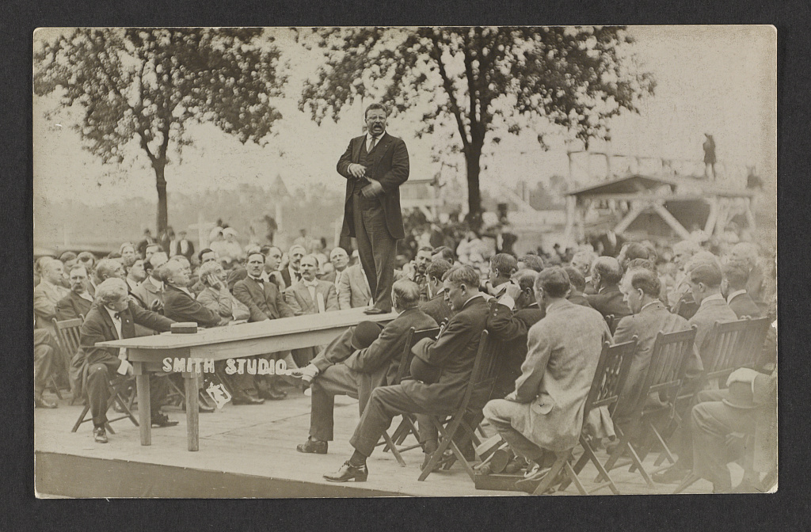

Slide 10
Body Position and Stance
Stand where your audience can see you
Formal stance
Avoid rocking, bouncing, swaying
Try walking around the front of the room if you are comfortable doing so—if you are not, STAY IN ONE PLACE!
Distracting Stances
Hip sit
Podium clutch
Table lean
Table sit

Slide 13
Eye Contact & Facial Expression
Look at a person long enough to complete a thought – then move on to another person
Look to the far sides of the room
Match your facial expression to the content of your presentation
Interact with the audience, as appropriate
Smile, when appropriate
Your facial expression allows you to convey
interest & enthusiasm confidence

Slide 14
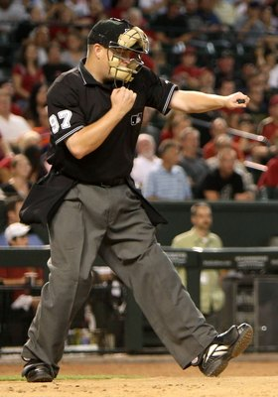
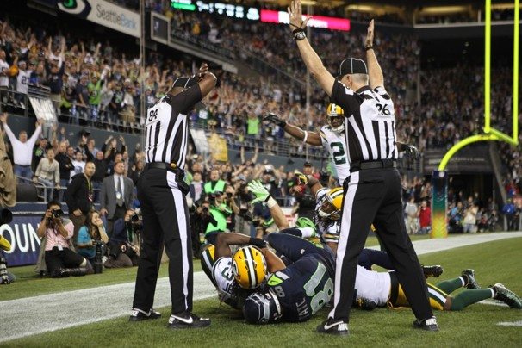

Slide 15
Gestures
Keep your hands in THE ZONE
Know your style
Gestures should match your message
Adapt to room size, audience, presentation type
Distracting gestures
Commander
Chilly Presenter
Gun-shot Victim
Armless Presenter
Pocket Jingler
Card Flicker
Figleaf
The proper way to point

Slide 17
Don’t face your
visuals!

Slide 18
Idea/Word Images – Stoplight / Trend
 | Quality |  | Business |  | Strategy
 |  |  |  |  | Global |  | Verticals
Products and Process | This would be a lot of cool words to explain what is going on here Evidence of leadership |  | This would be a lot of cool words to explain what is going on here |  | This would be a lot of cool words to explain what is going on here |  | This would be a lot of cool words to explain what is going on here
Global Brand & Premier Position | This would be a lot of cool words to explain what is going on here |  | This would be a lot of cool words to explain what is going on here |  | This would be a lot of cool words to explain what is going on here |  | This would be a lot of cool words to explain what is going on here
Relationships: Customers & Partners | This would be a lot of cool words to explain what is going on here |  | This would be a lot of cool words to explain what is going on here |  | This would be a lot of cool words to explain what is going on here |  | Execution More cool More cool More cool More cool
Resources: Money & Talent | This would be a lot of cool words to explain what is going on here More cool stuff Even more cool stuff |  | This would be a lot of cool words to explain what is going on here |  | Implementation More cool More cool More cool More cool |  | Implementation More cool More cool More cool More cool
TBD

Slide 19
Have high impact, interesting, yet simple
visuals!

Slide 21
Answering Questions
Anticipate questions, prepare for them, and practice response
Encourage questions (ask and then wait)
Listen during questions (don’t interrupt)
Restate/paraphrase, to EVERYONE
Question if you don’t understand
Direct answer to EVERYONE, not just the questioner
If you don’t know the answer, say so
If more questions than time, let audience know when and how you will cut off questioning
What if you get a hostile questioner?
What if your last question ends things on a bad note?
After Q&A, before you end, restate your proposed solution

Slide 22
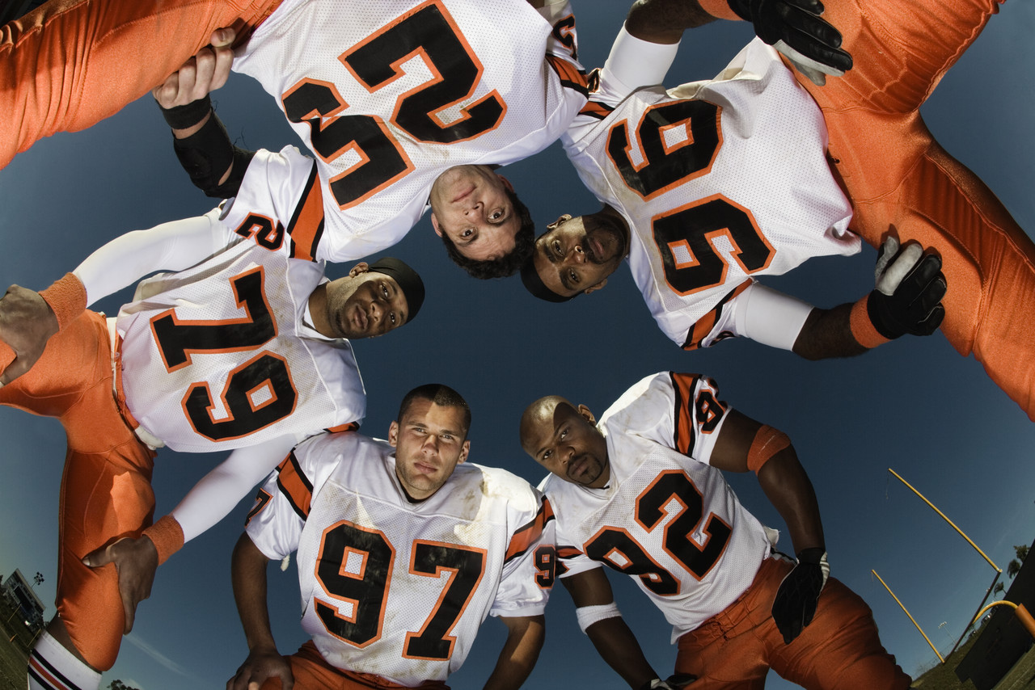
Don’t Huddle!

Slide 23
Practice, practice, practice.
3:30 max for video
4:30 max for presentation
2:00 for questions

